Slide 1

Radar Surveillance Equation and FMCW Radar
Take known parameters of FMCW radars from datasheets, calculation of surveillance parameters (Dwell time, modulation time, Numbers of pulses, Scan time, Gain);
From surveillance radar equation take SNR value necessary to detect a drone at given maximum distance;
Given the previous SNR value by decreasing the maximum distance obatin the mean power necessary to detect a drone; (given assumption on surveillance parameters)

Slide 2
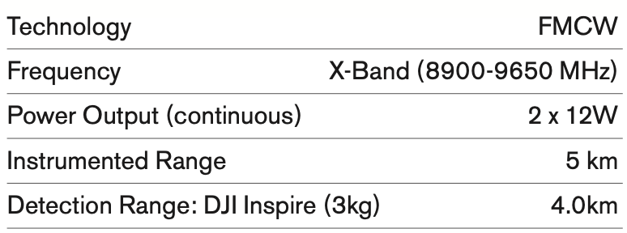
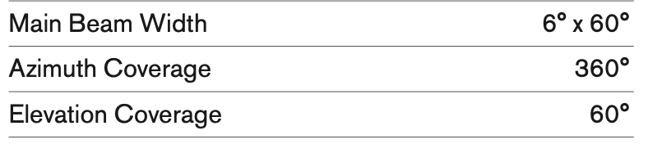
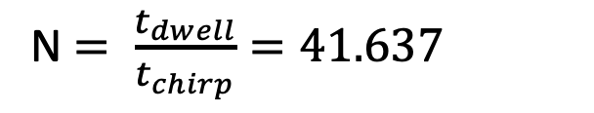

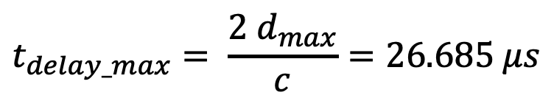


Real Radar Parameters
Iris specifications:
Radar Surveillance parameters:
$t_{dwell}= \frac{θ_{az}}{6 rpm}$ = $33.3 ms$
$$t_{delay_max}= \frac{2 d_{max}}{c}=26.685 μs$$
$t_{chirp}=30 t_{delay_max}$= $0.8 ms$
N $= \frac{t_{dwell}}{t_{chirp}}=41.637$
$$σ=0.03 m^{2}$$
(DJI Inspire 3 kg)

Slide 3

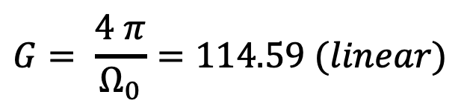


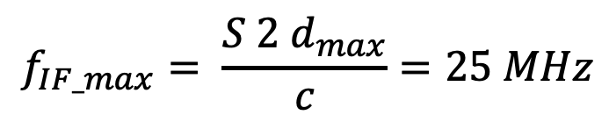

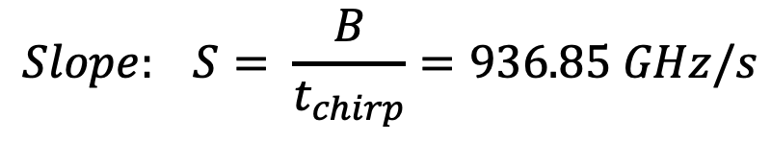


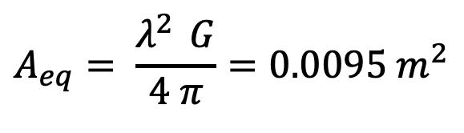
Real Radar Parameters
Radar surveillance parameters:
FMCW Radar Parameters:
$$Ω_{s}= θ_{az_cov}{ θ}_{el_cov}=6.579 sterad$$
$$B=f_{up}− f_{down}=750 MHz$$
$$Ω_{0}= θ_{az}{ θ}_{el}=0.1097 sterad$$
$$Slope: S= \frac{B}{t_{chirp}}=936.85 GHz/s$$
$N_{pos}$ $= \frac{Ω_{s}}{Ω_{0}}=60$
$$f_{IF_max}= \frac{S 2 d_{max}}{c}=25 MHz$$
$t_{scan}= N_{pos} t_{dwell}$= $2 s$
$$G= \frac{4 π}{Ω_{0}}=114.59 (linear)$$
It’s possible now to compute the SNR value by
Radar surveillance equation:
$$A_{eq}= \frac{λ^{2 } G}{4 π}=0.0095 m^{2}$$

Slide 4
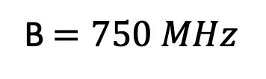


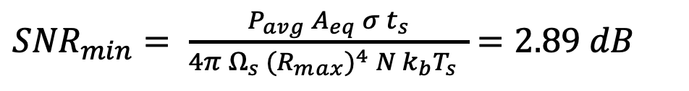






Real Radar Parameters
${SNR}_{min}= \frac{P_{avg}{ A}_{eq} σ t_{s}}{4π{ Ω}_{s} {{(R}_{max})}^{4} N{ k}_{b}T_{s} }$ $=2.89 dB$
$$N ∗ {SNR}_{min}=19.08 dB$$
Radar design
Assuming :
$$R_{max}=1000 m$$
$$rpm=30$$
$N∗SNR$ $=20 dB$
$$θ_{az}=10 °$$
B $=750 MHz$
$$σ=0.01{ m}^{2}$$
$$θ_{el}=40 °$$
$f_{0}$ $=9 GHz$

Slide 5
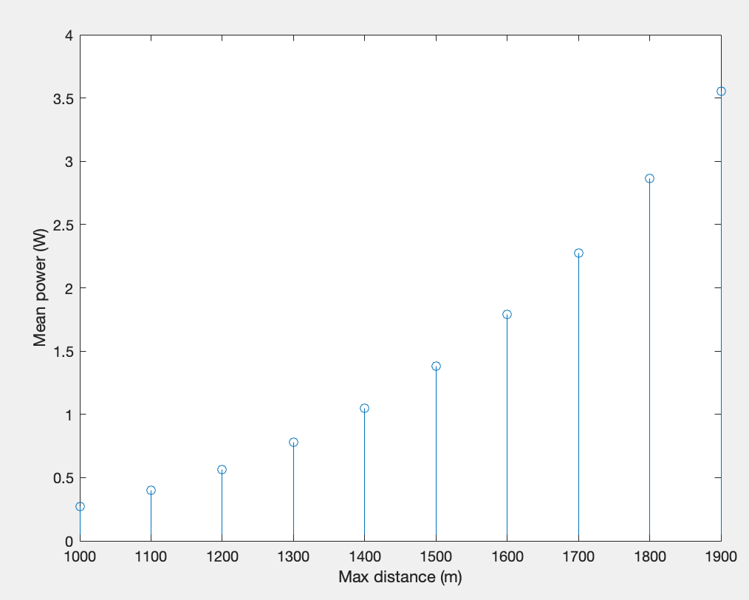

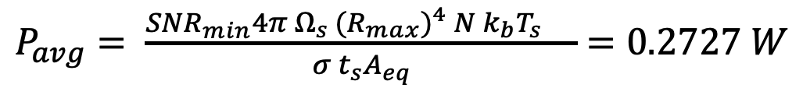






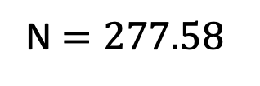


Radar design
Compute surveillance parameters:
$t_{dwell}$ = $55.6 ms$
$P_{avg}= \frac{{SNR}_{min}{4π{ Ω}_{s} {{(R}_{max})}^{4} N{ k}_{b}T_{s} }_{} }{σ t_{s}A_{eq}}$ $=0.2727 W$
$$t_{delay_max}= 6.672 μs$$
$$t_{chirp}=0.2 ms$$
For R ranges from 1 to 2 km:
N $=277.58$
$$Ω_{s}= 6.579 sterad$$
$$Ω_{0}=0.1828 sterad$$
$N_{pos}$ $=36$
$t_{scan}$= $2 s$
$$G=68.75 (linear)$$
$$A_{eq}=0.0061 m^{2}$$

Slide 6
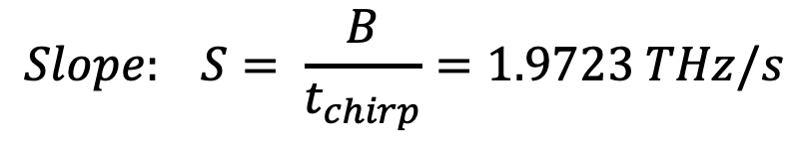
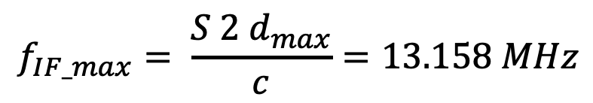
Radar design
Compute FMCW parameters:
$$Slope: S= \frac{B}{t_{chirp}}=1.9723 THz/s$$
$$f_{IF_max}= \frac{S 2 d_{max}}{c}=13.158 MHz$$

